Slide 1
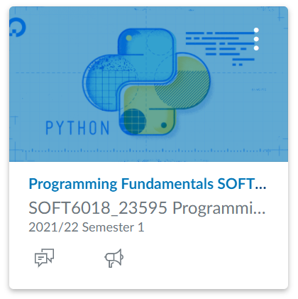
SOFT6018: Programming Fundamentals
Week 3 - Lecture 5

Slide 2

Concept review
Keyboard input
Use input() to get keyboard input, always processed as a string
f-strings
f-strings start with f"" and use {} as placeholders
Format specifiers are used to format the values
Type conversion
int() – convert argument to an integer
float() – convert argument to a float
str() – convert argument to a string

Slide 3
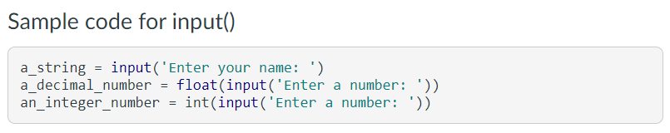
Keyboard input in Python
Check documentation for a function in PyCharm using ctrl+q
input() always treats what the user typed as a string
Functions to convert strings to numbers

Slide 4
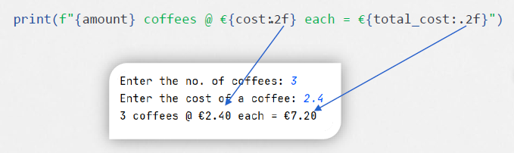
Formatting placeholders
{ placeholder : format specifier }
the colon (:) starts the formatting specification
the precision designator (.2) shows how many decimal places
the type designator (f) shows the type of number

Slide 5
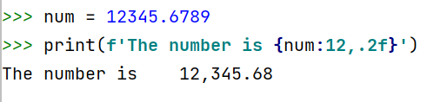
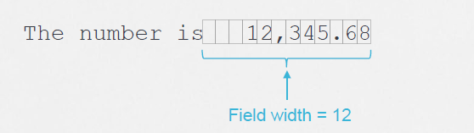
Specifying a minimum field width
Try this ->

Slide 6
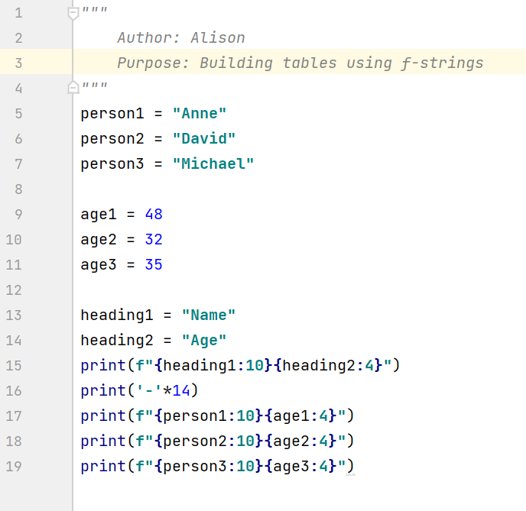
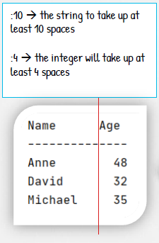
f-strings generating tables
Try this ->

Slide 7
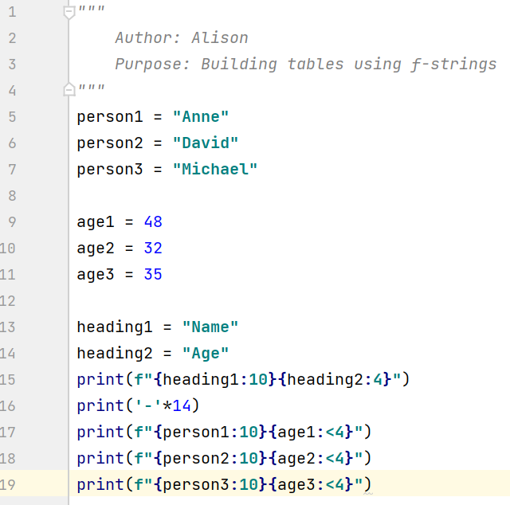
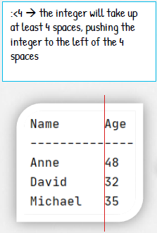
f-strings generating tables (alignment)

Slide 8
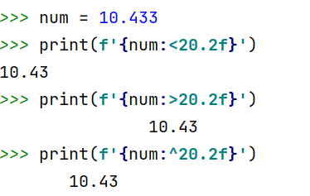
Aligning values within a field
Use < for left alignment
Use > for right alignment
Use ^ for centre alignment
Examples

Slide 9
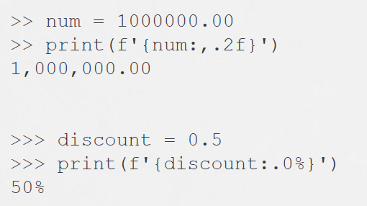
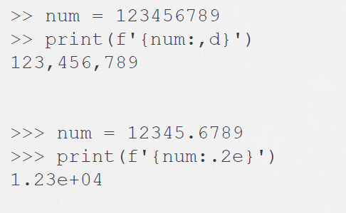
f-string examples (homework)

Slide 10
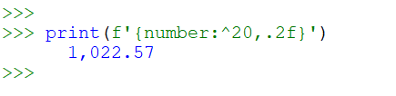
f-string designator order
The order of designators in a format specifier
[alignment][width][,][.precision][type]
Example

Slide 11
Software development is the process of going from a client’s requirements to a full solution

Slide 12
Understand what the client wants/needs
You will learn about this in Requirements Engineering in 2nd year
Design a solution
Implement the design and test the code

Slide 13
IPO
Processing
What must be done to go from the input to the output?
The series of steps produced here is called an algorithm
This is usually the most difficult task!
Input
Establish what data you need from the user – the inputs
What are the datatypes?
Output
What do you want to calculate for the user?
What do you want to show the user?

Slide 14


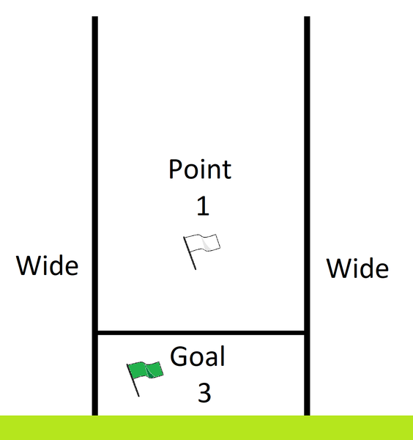

Consider the following challenge….
A program should get the name and score of a team in a GAA match and determine the total score in points.
In case you don't know….
In GAA, a score is made up of two elements:
Points – over the bar
Goals – under the bar & worth 3 points

Slide 15
The inputs?
Name of the team <string>
Number of goals <int>
Number of points <int>

Slide 16
The outputs?
A nicely formatted sentence with the name of the team, their score and the total points earned <string>

Slide 17
The processing?
total_points = goals*3 + points

Slide 18
IPO
Name of the team <string>
Number of goals <int>
Number of points <int>
total_points = goals*3 + points
A nicely formatted sentence with the name of the team, their score and the total points earned <string>

Slide 19
Algorithm
Ask for and read team's name
Ask for and read number of goals
Ask for and read number of points
total_points = goals * 3 + points
Display name, goals, points and total_points

Slide 20
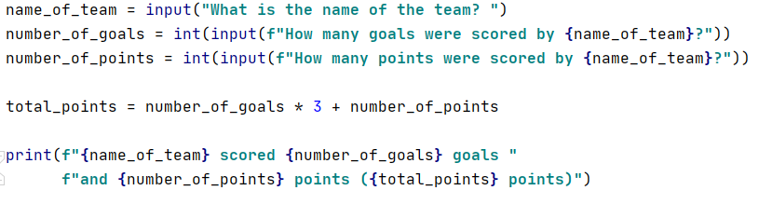
Algorithm

Slide 21
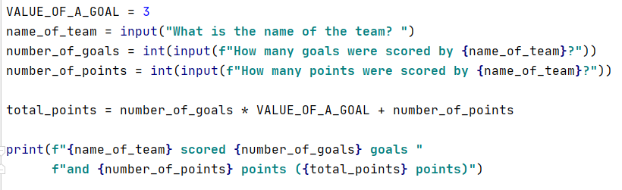
Algorithm – Improving readability
Replace the "magic number" 3 with a named constant to help others to read & understand your code
Also helps to quickly edit in the future

